Slide 1
IBM Capstone Project

Slide 2
Introduction
With COVID-19 throwing the economic world into a frenzy many small businesses, and large corporate ones for that matter, have either filed for bankruptcy or closed their doors for good. Unfortunate as this is, up and coming entrepreneurs will face an unprecedented market of corporate real estate for new businesses. Restaurants, Bars/Pubs, Cafes, etc. will have an opportunity to open in prime areas for foot traffic and income when the world returns to normalcy or creates a new normalcy after the COVID-19 threat has subsided. Analysis on neighborhoods and current establishments to find an ideal storefront will become ever important in the coming months and years. This data will be invaluable to new start-ups and can assist them in getting the right patronage and make sure that their business income will be consistent. It will take the guess work out of where to open a business.
New York City (NYC) is one of the busiest and most lucrative cities in the entire world for business. The previously mentioned commercial real estate market is one of the most contentious because of it. Ranging anywhere from 50 to over 200 U.S. dollars per square foot can cause rent prices and mortgages to skyrocket for even a small brick and mortar venue. That is why picking the most ideal real estate is a pivotal part of setting up shop, so to speak, in NYC. There needs to be a guarantee that a business will not lose too much profit to rent and upkeep of an NYC storefront.

Slide 3
Business Problem
Craft Beer has become an ever-expansive market and is especially popular with 22-35-year-old males, but the female market is growing as well. Currently it accounts for 13.2% of all US beer volumes and has a 24.1% market share at about 27.6 billion US Dollars. That number continues to grow at about 7% a year. With that growth rate it is a very lucrative business to be involved in and now is better time than any to open a microbrewery. My client, a brewer from the Tri-State area, was looking at the commercial real estate in NYC because it ranks fourth in the country for craft breweries and there are many neighborhoods that look enticing for a new brewery.
As an entrepreneur my client has expressed interest in the NYC area for his new craft brewery, pub/lounge, but he wants to pick the right neighborhood for this establishment. With that problem we can assess the things required for his business venture, he will need a middle to upper class neighborhood or borough and an area where there are few other establishments like his but not completely devoid of other establishments. He would like a list of potential neighborhoods for his new start up that fit his criteria so he can start looking for open corporate real estate.

Slide 4
Data and Methodology
I was able to procure the median household income for each borough and neighborhood in NYC from https://www.renthop.com/study/assets/new-york-city-cost-of-living-2017/nyc-2br-median-rent-and-income-table.html.
Then the Foursquare API will be utilized to find the current percentages of venues in the neighborhoods that seem the most promising and from there analyze which neighborhoods would be ideal for my client. The API will provide the information regarding the top business types in each neighborhood which will allow me to figure out where a craft beer pub and lounge would be best suited to get the right consistent patronage.

Slide 5

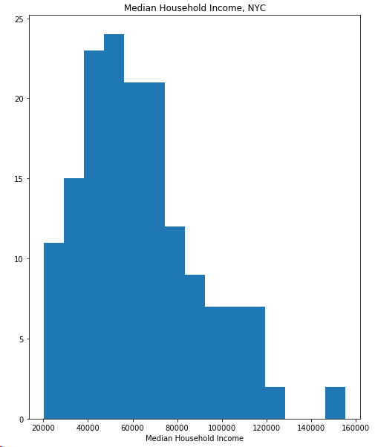
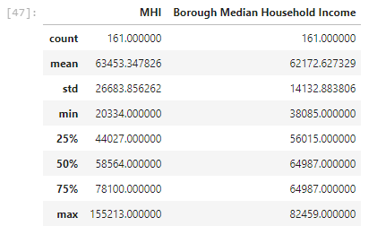
Analyzing the Data
The histogram and description of median household income skews right but the center is around 60K which creates the cutoff point.

Slide 6
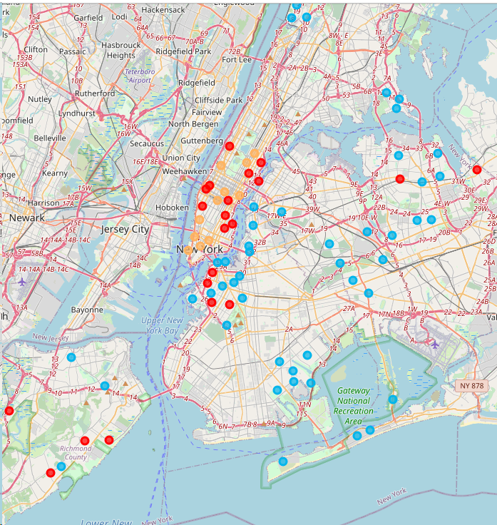
K-means groupings
Judging by the clustering of the data cluster 4 (Orange) seems to be the best markets for my client. The median income is far above what the client requested, and bars rank low on frequency; that includes cocktail, and wine bars.
This is better shown on the next slide.

Slide 7

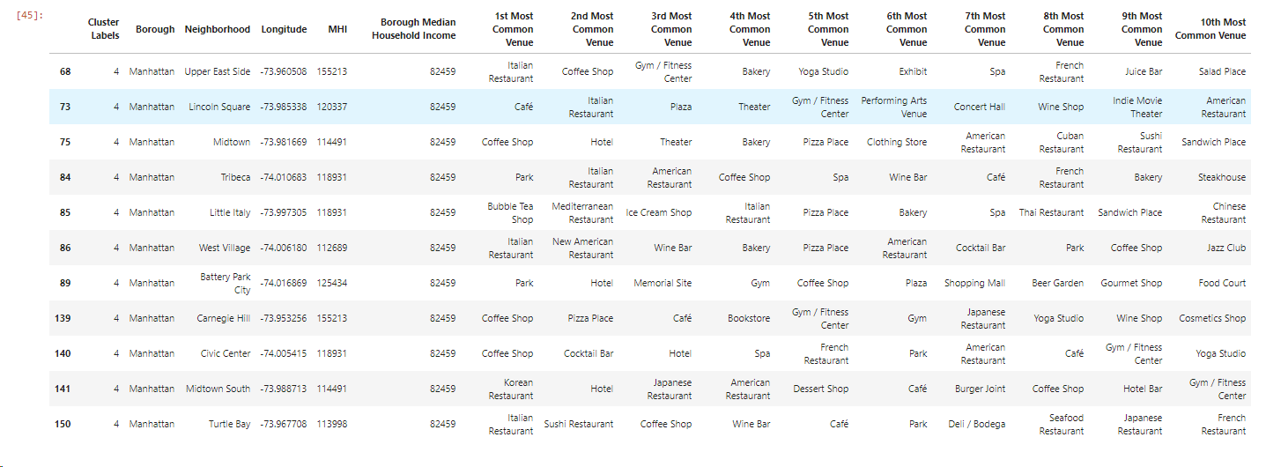




Slide 8
Conclusion
Each neighborhood has a good diversity of other establishments where it is not just a bunch of parks or other open areas with little else in the vicinity. The other clusters have bars rank 4th or higher on the frequency in the neighborhoods which means my client’s share of the patron pie would be smaller than that of cluster 4. This would make him more likely to be in the black and offset the higher rent that comes with the neighborhoods in Manhattan which is exclusively where cluster 4 is located.
Further investigation could be done to understand the commercial rents of each area as well, but I was unable to procure that data. That data would allow me to assess the monthly revenue the client would need to make to have a profit in each neighborhood that would fit his requirements. Another piece of data I was unable to obtain but could be beneficial to this analysis would be the age range of each neighborhood i.e. what the median age is. Most craft beer drinkers are around 22-34 years old so finding neighborhoods with large populations of that age group would also be ideal.

